Slide 1
CS/EE/ME 75(a)
Nov. 19, 2018
Today:
        Evaluate Alternatives
        Layout & Details
        Homework

Slide 2
Structured Design Method(s)
Recognition of a Need
Clarification of Objectives
Establish Function
Set Requirements
Problem Definition
Generate Alternatives
Evaluate Alternatives
Create Details
Solution Generation
Analysis & Optimization
Preliminary Design Review!
Prototyping

Slide 3
Structured Design Method(s)
Recognition of a Need
Generate Alternatives
  Morphology chart
Evaluate Alternatives
  Idea Scoring/Ranking
Create Details/Layout
Problem Definition
Solution Generation
Analysis & Optimization
Prototyping

Slide 4
Generate Solutions
              Goal:
                Create as many distinct solutions as possible.
                Create many possible alternative rearrangement of components
                Organize alternatives for future evaluations
                Classify alternatives
            Morphology Chart (best for electromechanical design problems):
                Required functions/features along rows
                Different design alternatives and combinations along rows.
                Phrases or sketches to capture the concept
            Sometimes other alternatives, such as concept diagrams or classification trees, are better suited to a given problem

Slide 5
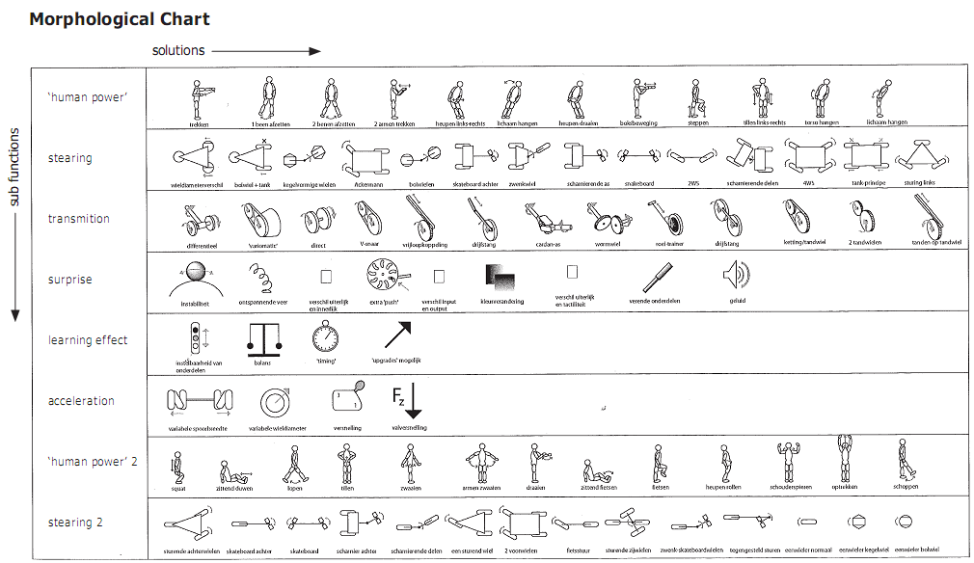

Slide 6
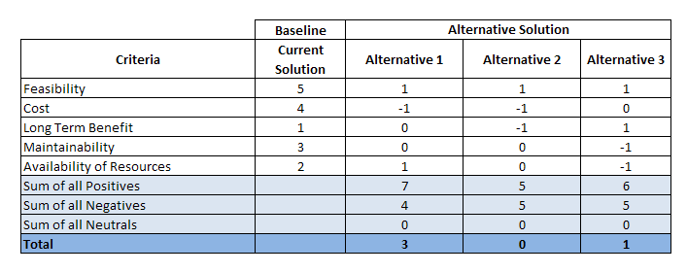
Pugh Analysis, Pugh Matrix

Slide 7
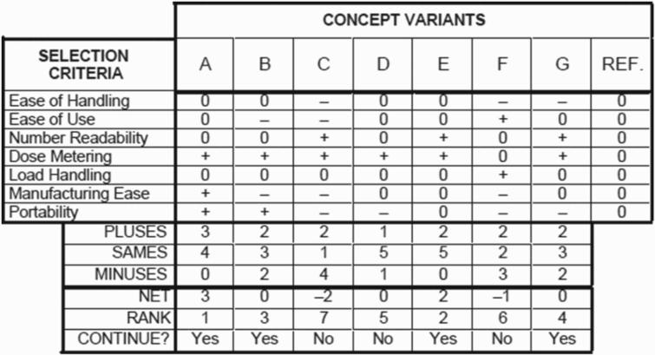

Slide 8
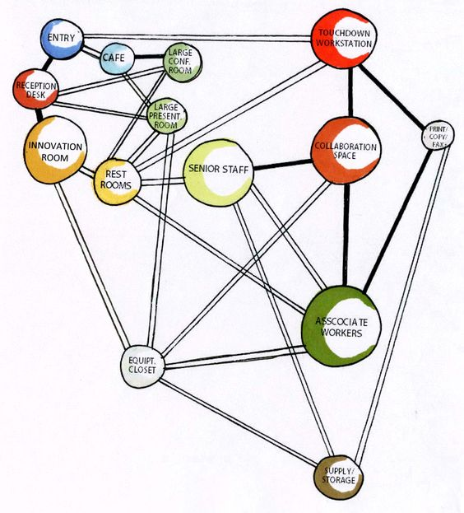
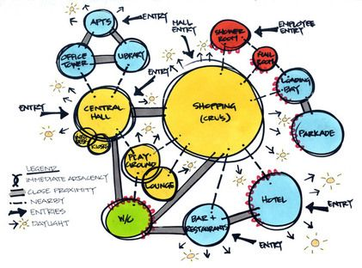
Initial Layout: Bubble Diagram

Slide 9
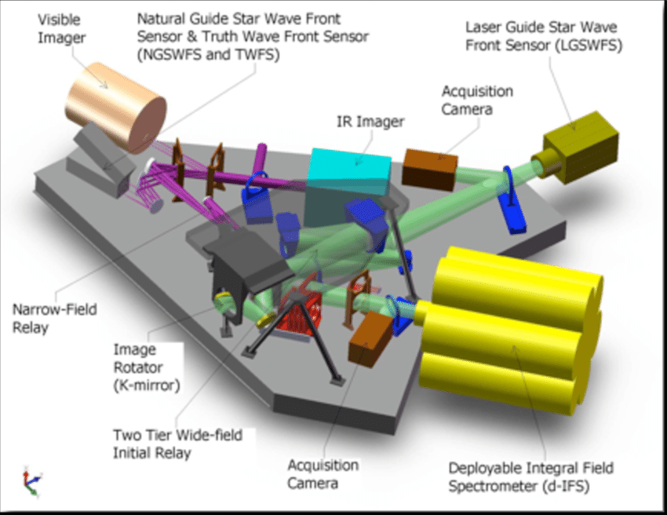

Slide 10
Homework
Develop a scoring system for your morphologies & Design Alternatives
Rank your alternatives. Select, as appropriate, ideas for continuation
Rough Layout of your solution.

