Slide 1
CS/EE/ME 75(a)
Nov. 19, 2018
Today:
        Prelimnary Design Review
        Homework

Slide 2
Structured Design Method(s)
Recognition of a Need
Clarification of Objectives
Establish Function
Set Requirements
Problem Definition
Generate Alternatives
Evaluate Alternatives
Create Details
Solution Generation
Analysis & Optimization
Preliminary Design Review!
Prototyping

Slide 3
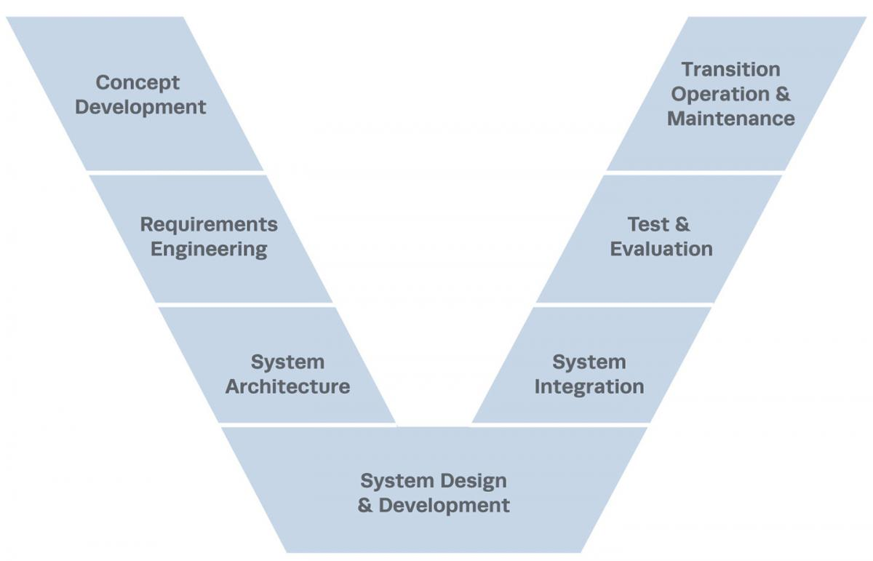
The “V” Model of Systems Engineering

Slide 4
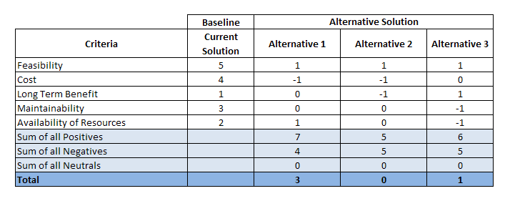
Pugh Analysis, Pugh Matrix

Slide 5
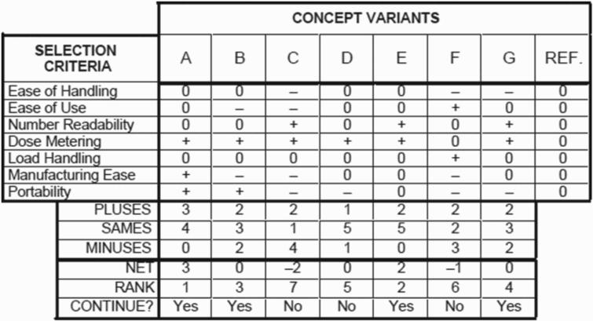

Slide 6
Weighted Objectives Method
provides a way to systematically evaluate and compare concepts
Procedure
  List the design objectives
  Rank-order the list of objectives
  Assign relative weightings to the objectives
  Evaluate and compare the relative utility values of the alternative designs

Slide 7
Ranking and Weighting Objectives
This part of the process is highly subjective
Ranking can be done using a pair-wise comparison
  This becomes more cumbersome with more objectives
Weighting can be done based on the ranking
  This is even more subjective
A simple way to perform these steps is to examine the objective tree and weight each level and sub-level.
  The ranking and weighting will drop out of this examination

Slide 8
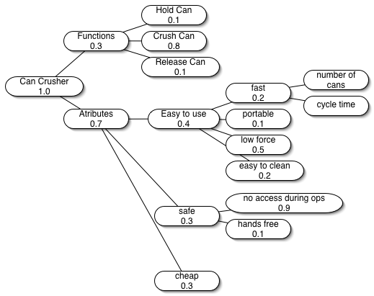
Weighted Objective Tree

Slide 9
Weighting Matrix
Attribute | Level 1 | Level 2 | Level 3 | Total
Hold Can | 0.3 | 0.1 | 1 | 0.03
Crush Can | 0.3 | 0.8 | 1 | 0.24
Release Can | 0.3 | 0.1 | 1 | 0.03
Fast | 0.7 | 0.4 | 0.2 | 0.056
Portable | 0.7 | 0.4 | 0.1 | 0.028
Low force | 0.7 | 0.4 | 0.5 | 0.14
East to Clean | 0.7 | 0.4 | 0.2 | 0.056
Limit Access | 0.7 | 0.3 | 0.9 | 0.189
Hands Free | 0.7 | 0.3 | 0.1 | 0.021
Cheap | 0.7 | 0.3 | 1 | 0.21

Slide 10
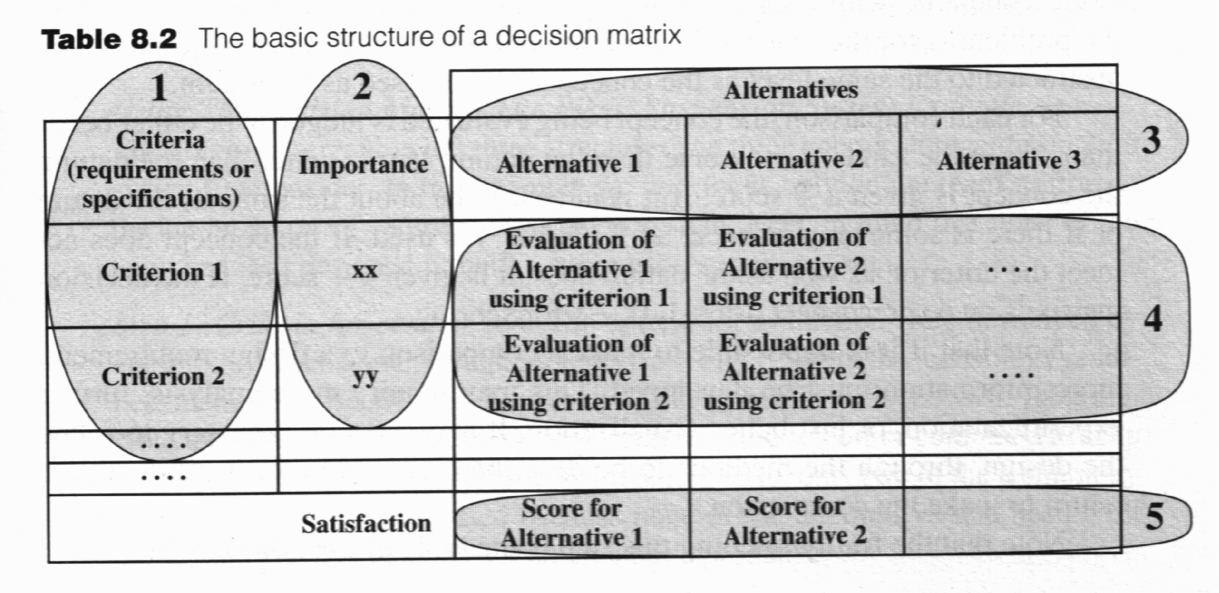
Putting it all together
Choose the criteria for comparison (leaves of the objective tree)
Develop relative importance weighting (based on objective tree)
Select the alternatives to be compared (from pruning the initial concepts)
Evaluate alternatives (relative comparison +,–,0)
  Pick one to be the datum or baseline concept, and compare all designs to that one
Compute the satisfaction

Slide 11
Common Design Review Procedures
System Requirements Review (SRR).
    review system requirements to ensure the documented requirements reflect current knowledge of needs
    identify requirements that may not be consistent with development constraints,
    put the requirements document under version control to serve as a stable baseline for continued development.
    Preliminary Design Review (PDR).
    Reviews the conceptual design to ensure that the planned technical approach has a good chance of meeting requirements.
    Identify issues which need further consideration and analysis
    Identify Risks

Slide 12
Common Design Review Procedures
Critical Design Review (CDR).
  Review the detailed design to ensure that the proposed implementation has met the system requirements.
Test Readiness Review (TRR).
Review preparations and readiness for testing of mechanical, electrical, and software configuration items, including adequate version identification of software and test procedures.
Production Readiness Review (PRR).
Ensure that the design is completely and accurately documented and ready for formal release to manufacturing.

Slide 13
Preliminary Design Review
A review conducted to evaluate the progress, technical adequacy, and risk resolution of the selected design approach for one or more configuration items;
to determine each subcomponent design's compatibility with the requirements;
to evaluate the degree of definition and assess the technical risk associated with the selected manufacturing methods and processes;
to establish the existence and compatibility of the physical and functional interfaces among the configuration items and other items of equipment, facilities, software and personnel;
and, as applicable, to evaluate the preliminary operational and support documents.
(ISO/IEC/IEEE 24765 2009)

Slide 14
General PDR Success Criteria
  The proposed design appears to meet the objectives, requirements, and performance goals.
  There are adequate margins at this stage of the design. I.e., the design is “robust”
  The design can meet interface requirements and constraints. I.e., it can fit into the system.
  Problem areas, open areas, and known risks are identified.
  There are concrete plans to resolve open issues, consistent with available resources.
  Integration and test plans are adequate.
  The project has defined plans and processes in place for managing and controlling the development and operation of the mission deployment.

Slide 15
Homework
Start organizing your team for your PDR.

