Slide 1
CS/EE/ME 75(C): Week 4 (5)
House Keeping:
  Course Zoom Link: https://caltech.zoom.us/j/282171019
  Maybe a tutorial session on Friday?
Last Steps Before reaching our first real goal (starting your own team simulations)!
Finish a basic understanding Gazebo
  Integrating sensors into Gazebo (do a tutorial …)
  What are plugins, and how do they work?
2) Start understanding the basics of ROS control and interfacing
  Learn how to simulate using Gazebo, and visualize using RViz
  Write an SDF for Gazebo, which will create an URDF for Rviz

Slide 2
A simulator can mimic many (but not all) aspects of a real world robot deployment
  Simulate robot geometry & movements
  Simulate obstacles, objects in the robot’s environment
  Simulate sensor readings and sensor feedback process
  Simulate physical interactions between objects
    Most difficult & sensitive simulation
Why use simulation?
  Debug code before testing it in high-cost-of-failure real world situations
  Test on hardware which is not available
  Allow for parallel development across sub-teams
  Create visualization videos

Slide 3
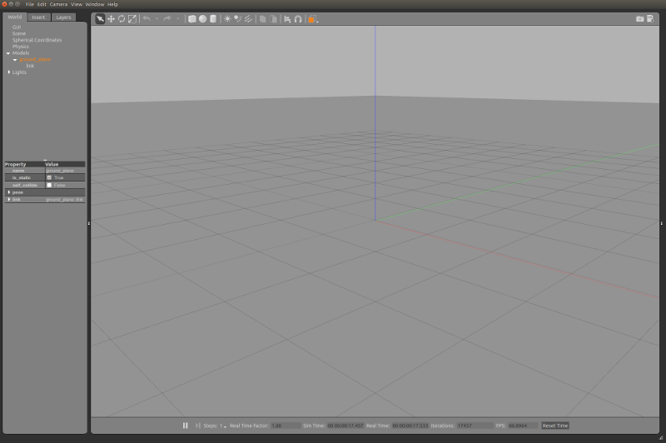
Gazebo Simulation Architecture
Worlds: Contains all simulation elements
  Robots, Static Objects
  Sensors, Lights
Models: describe the robot
  Geometry, kinematics of links
    Appearance
    collision
  dynamic parameters (for sim
  visual appearance
  Interface information
Sensors: locations & sensor type
Plugins: allow programmed interaction with simulation elements
Gazebo implemented as a simulation server and a GUI client

Slide 4
General Gazebo/ROS Simulation Workflow (updated)
  Launch a world into Gazebo:
    The launch starts up the world model in Gazebo, as well as the nodes that will control a real robot. But now they control a simulated robot.
  The last lecture was about Gazebo’s worlds, and how to start them within a simulation.
  This lecture summarizes how we can define feedback control systems in ROS, and what we must do to allow these closed loop systems to operate in simulation.
    Plugins: allow interaction between ROS & Gazebo
    ROS Control

Slide 5
Gazebo Plugins
Why a Plugin?
  We need a way for ROS (or other external programs) to modify the Gazebo simulated worlds
    Send torques to the simulated robots’ motors. The “physics engine” then uses its kinematic/dynamic models to predict how the robot will move under the commands
    Change lighting conditions or other states/parameters of the simulated world
  The external programs need a way to access the states of the simulated world and robots
    Sense the current simulated values of the robot joint variables
    Get the data streamed from the simulated exteroceptors, such as simulated cameras, lidars, ultrasound, etc.
What is a Plugin?
  Implemented as a shared library
  Dynamically linked (at load time) to Gazebo and ROS
  Often invoked during launch. But can be loaded/removed any time.

Slide 6
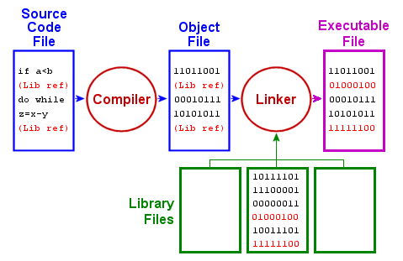
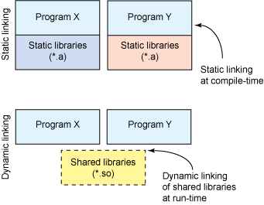
Plugins (continued)
Shared Library
Conventional Library Compilation Process
Dynamic linking of shared library

Slide 7
Plugins (continued)
Types of Plugins
  Different plugins manage different parts of the simulation framework
  World plugin: modify world settings
    E.g., lighting conditions, locations of fixed objects, presence/absence of a robot
  Model plugin: interact with the model (e.g., send simulated commands)
  Sensor plugin: interaction with simulated sensors (e.g., camera)
  System plugin: effect system-level actions, like time/network synch.
  Visual plugin: change the sim. rendering process (e.g., camera view)
  GUI plugin: change or interact with how the user interface works
Most Important for Us

Slide 8
Plugins (continued)
How do we incorporate Plugins?
  Usually incorporated into appropriate xml file
    A model plugin will be included in the URDF/SDF file describing that model
    A sensor plugin will also go in the model file where the sensor is defined
  A combination of xml statements and the loading of a shared library
    Xml statements define model/sensor parameters
    Shared library is the compiled c++/python code
      Written with knowledge of ROS & Gazebo APIs: http://osrf-distributions.s3.amazonaws.com/gazebo/api/9.0.0/index.html
    Many existing shared libraries exist
  Created as a ROS package
  See: https://github.com/SMARTlab-Purdue/ros-tutorial-gazebo-simulation/wiki/Sec.-4:-Creating-a-light-sensor-plugin for an example

Slide 9
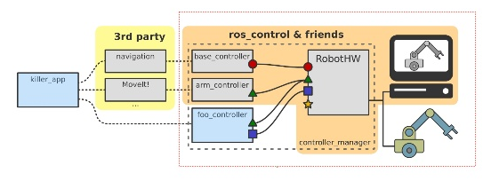
ROS Control
Every robot (real or simulated) needs a controller
  Create a “closed loop” between sensors and actuators to follow commands from: (1) teleoperation (joystick) or (2) a planner
  Typically there will be many different closed loop control systems needed control the
Usually these controllers are hardware/robot/problem specific
  Often depend on type of actuator and the goals of the robot’s assigned task
  Many theories Create a “closed loop” between sensors and actuators to follow commands from: (1) teleoperation (joystick) or (2) a planner
    CDS 110, CDS 141/241, CDS 242
  Typically there will be many different closed loop control systems are needed

Slide 10
ROS Control (continued)
ROS comes with some generic controllers
  Many types of robot joint control approaches are very similar:
    Most robot manipulators/arms are built with 6 or 7 revolute joints
    Most mobile robots are drive by wheels
    PID (proportional-integral-derivative) control is usually quite effective for joints/wheels
  ROS control allows you to get a system “up and running” quickly. You can develop high performance hardware specialized controllers later.
  ROS control documentation: https://wiki.ros.org/ros_control
ROS Control, and more generally ROS, wants to abstract the specifics of the hardware. This allows different planners and planning strategies to be interfaced readily with your hardware/simulation.
Several generic control layers and standards help achieve this goal:
  Controllers: the closed loop controllers. See https://github.com/ros-controls/ros_controllers for a list of the different types of controllers that already exist.

Slide 11
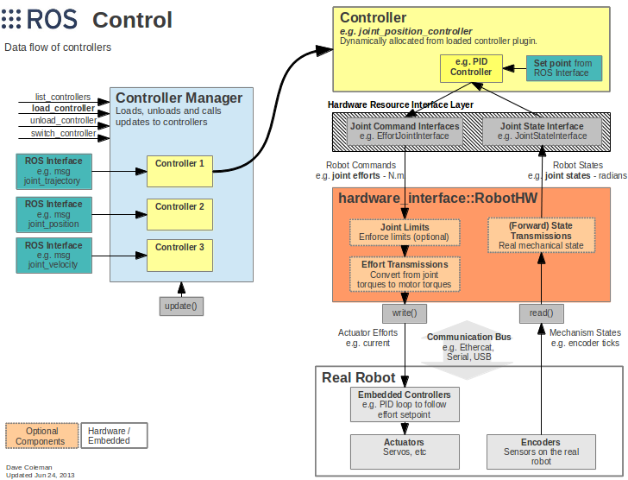
Effort controller commands joint torque/force
Position controllers servo a specific joint displacement
Velocity controllers maintain the actuator’s speed
Joint trajectory controllers to to follow a particular smooth path in joint space
Hardware Interfaces
Joint command interface (to send command)
Joint State Interface (to help read joint sensor info)
Transmission Layer
Account for transmission effects
Joint Limits Interface

Slide 12
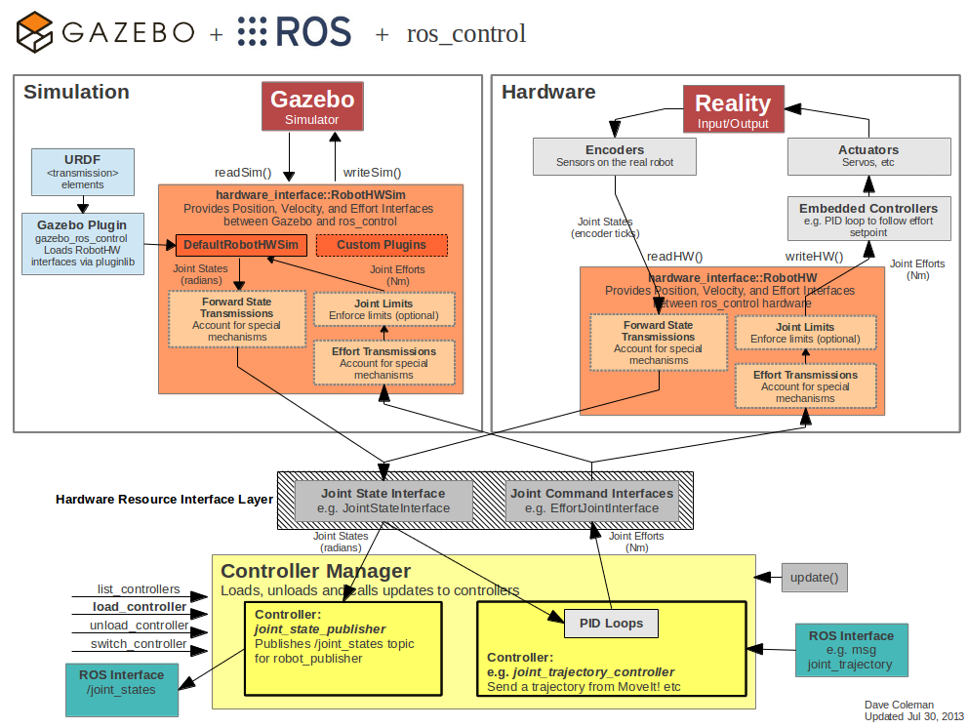
Controller Manager:
Loads/unloads controllers
Starts/stops/synchronizes controllers
Switches controllers
Manages controller rate
The main node of a ROS control system
  Subscribes to sensor data
  Subscribes to messages/plans from higher level planner

Slide 13
Homework: Week (4) 5
Goal 1: learn about Gazebo plugins
  Main page for Gazebo plugin tutorials/documents: http://gazebosim.org/tutorials?cat=write_plugin
  Read & complete the “plugins 101” tutorial: http://gazebosim.org/tutorials?tut=plugins_hello_world&cat=write_plugin
  This tutorial is a bit bland, but it is a useful first step.
  While you may eventually need to use every time of plugin for your team, let’s focus on these two key plugin types:
    Model plugins: http://gazebosim.org/tutorials?tut=plugins_model&cat=write_plugin
    World plugins: http://gazebosim.org/tutorials?tut=plugins_world&cat=write_plugin
Goal 2: Test your new knowledge of plugins:
  Execute this tutorial: http://gazebosim.org/tutorials?tut=ros_gzplugins . It will give you a flavor of using Gazebo and ROS at the same time.
  This example uses the rrbot model from last week’s exercises

Slide 14
Homework: Week (4) 5
Goal 3: learn about ROS Control
  Execute this tutorial: http://gazebosim.org/tutorials/?tut=ros_control
    This tutorial builds upon the previous rrbot tutorials
  If you haven’t visited the site already, you may want to skim over the ROS Control documentation page: http://wiki.ros.org/ros_control
  Also note the GitHub wiki on ros control: https://github.com/ros-controls/ros_control/wiki
    It has notes and pointers on building/implementing new controllers

